Slide 1
increasing transparency through a multiverse analysis
wolf vanpaemel
university of leuven
with sara steegen, francis tuerlinckx and andrew gelman
ICPS
symposium on pre-registration and full transparency in psychological science
march 25th 2017
vienna

Slide 2
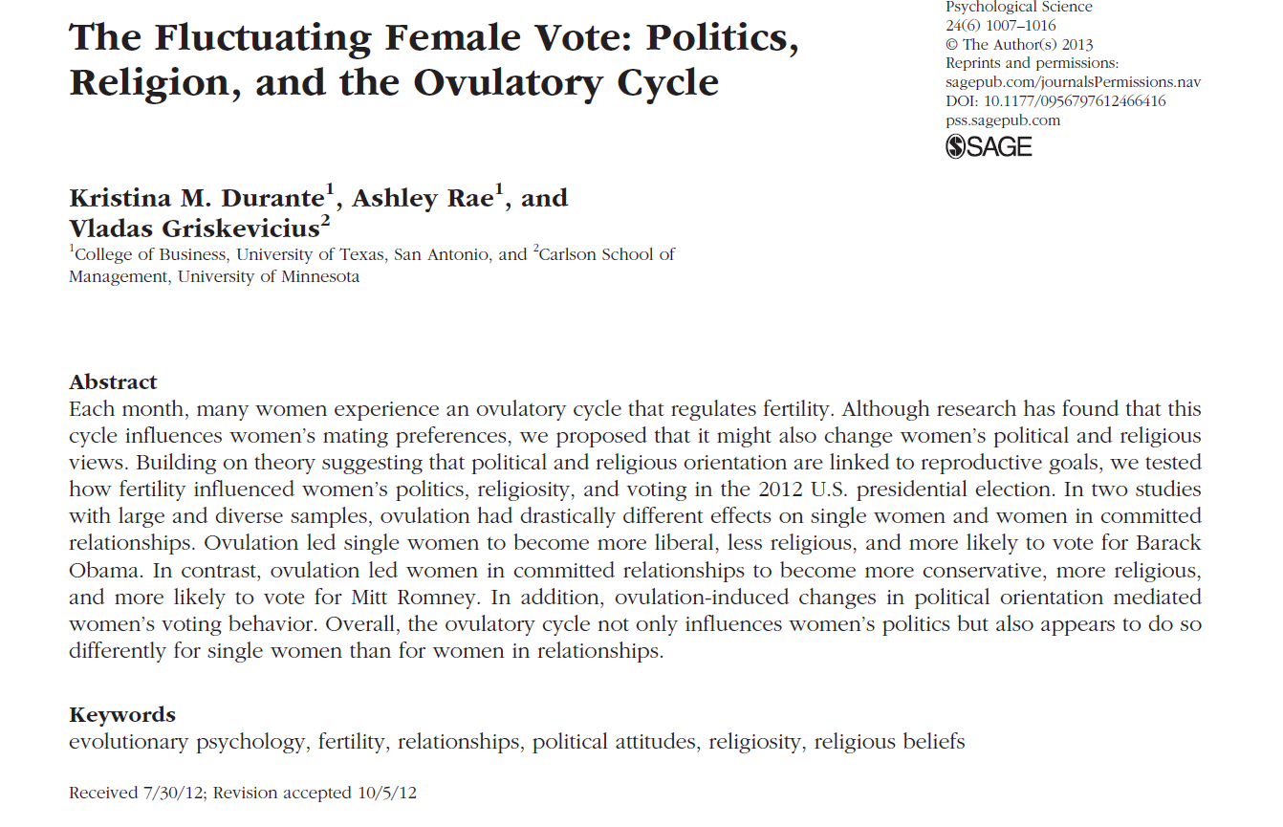

Slide 3
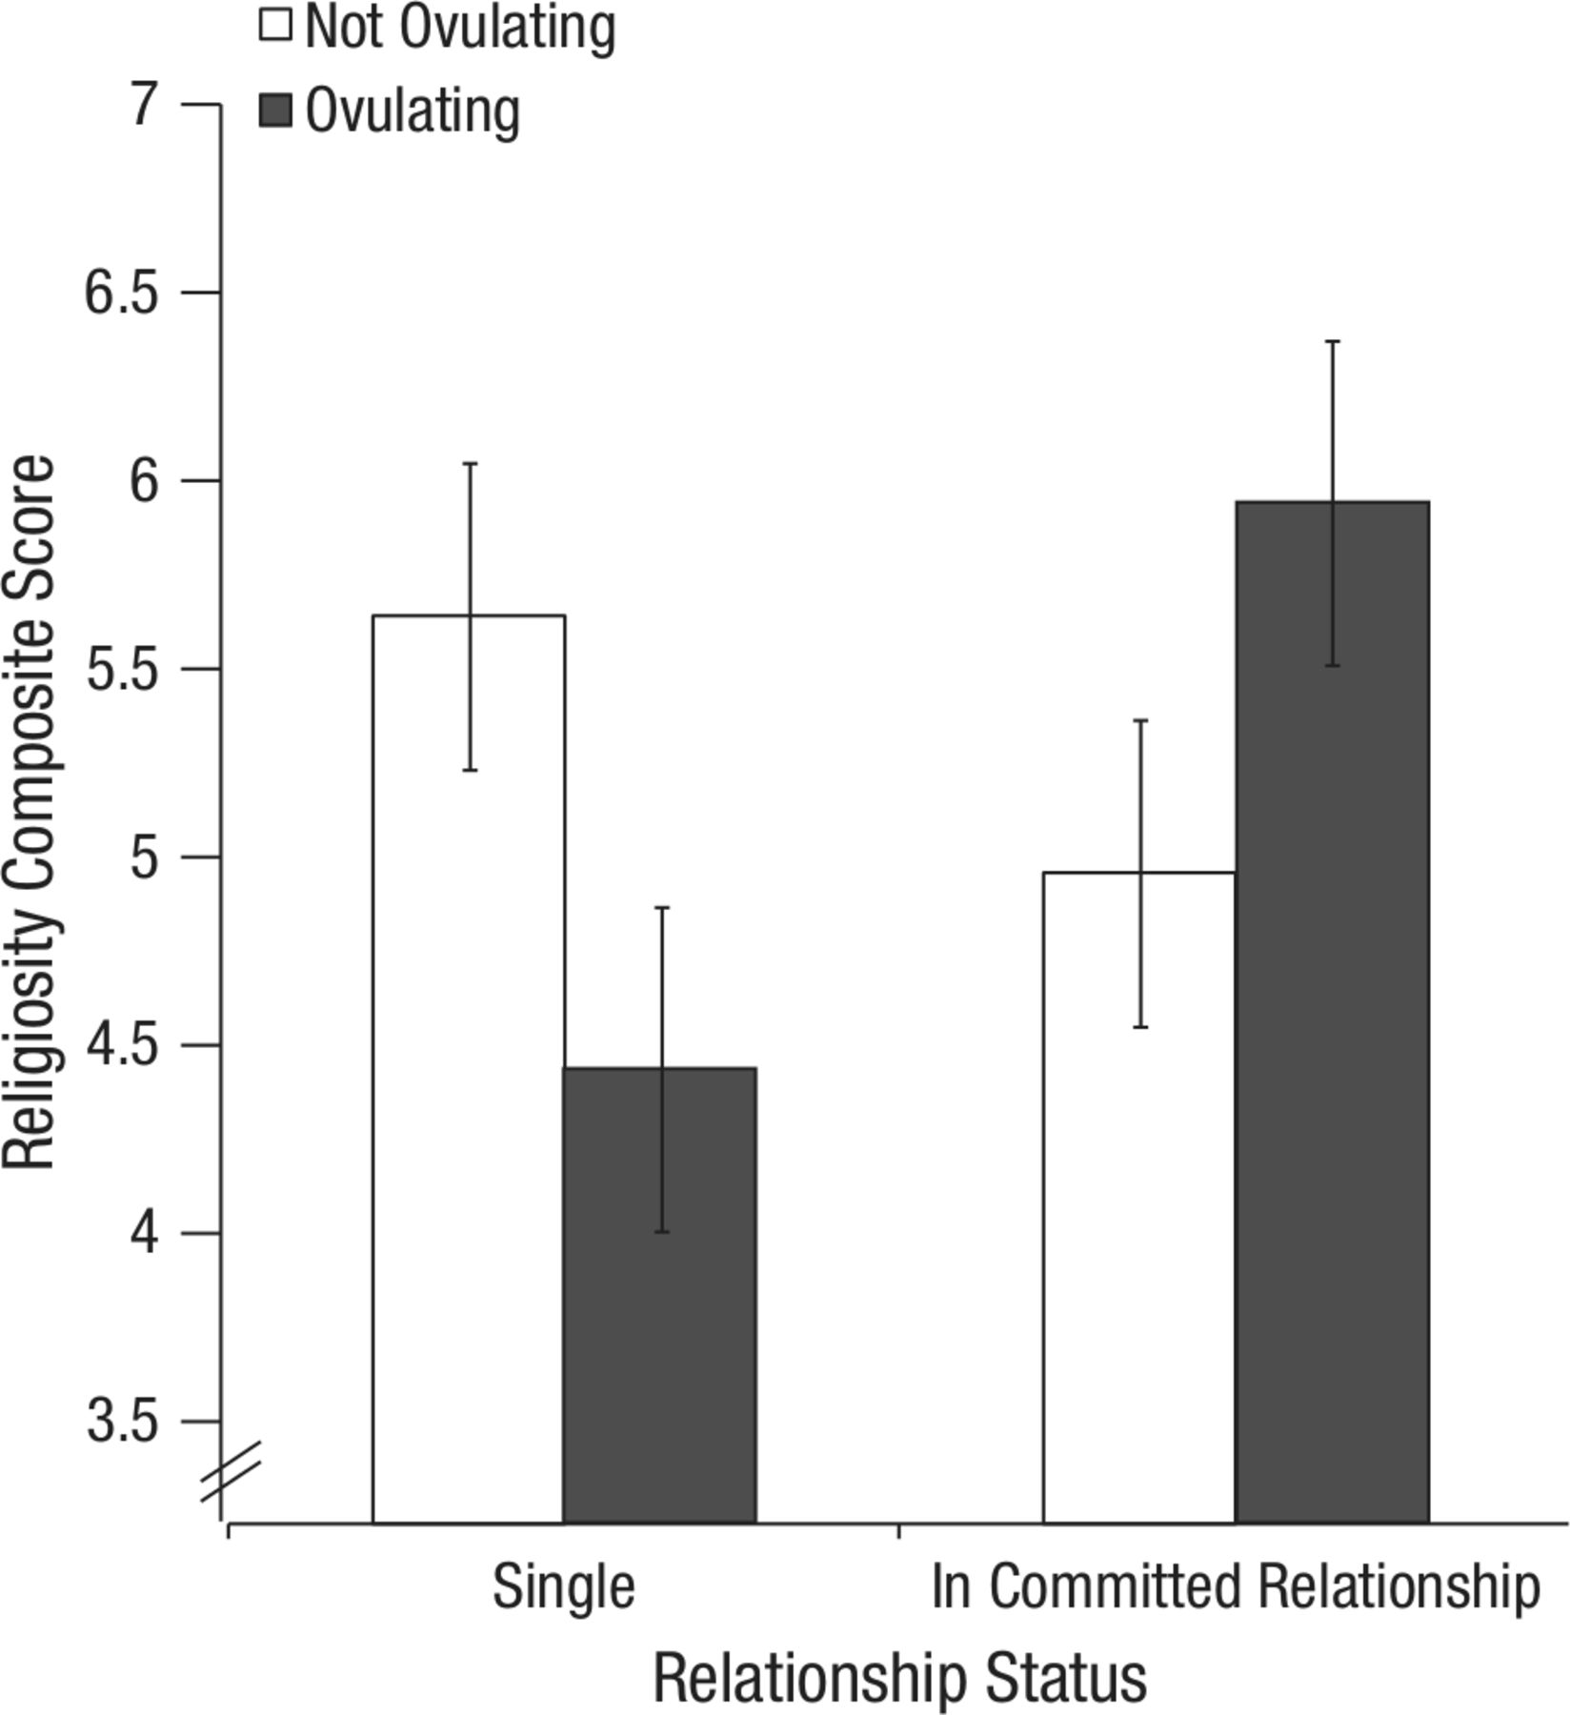
women’s religiosity as a function of fertility and relationship status
fertility x relationship status interaction,
F(1,159)=6.46, p=.012

Slide 4
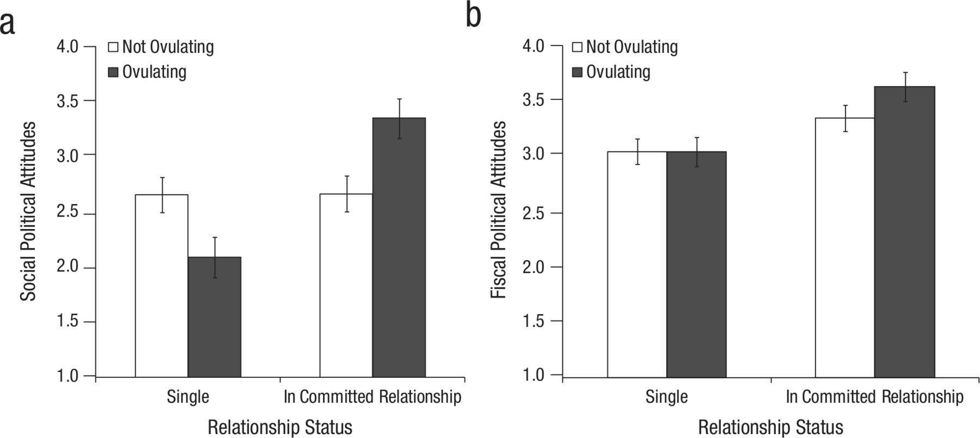
women’s social political attitudes (conservatism) as a function of fertility and relationship status
fertility x relationship status interaction, F(1,299)=12.26, p=.001

Slide 5
there are nice things to say about this study
relatively large sample size (275 in study 1, 502 in study 2)
attempt to relate the finding to (evolutionary) theory
the p-values are computed (mostly) correctly
in-paper replication of study 1
open data (on request, and now publically on https://osf.io/zj68b/)
it is used as a cautionary tale about
the impact arbitrary data processing choices have on statistical conclusions
the importance of assessing the analytical robustness of findings

Slide 6
analyses are based on the following data
fertility status (high vs low)
relationship status (single vs committed)
religiosity score (first example) or social political attitudes score (second example)
these data were not just “collected” or “observed”
the data were constructed

Slide 7
the observed, raw data include
answer to three statements on religiosity and five statements on social political attitudes (e.g., on abortion, marijuana, etc)
answer to a bunch of fertility related questions
the start of the last period
the start date of the period before the last period
the typical cycle length
the start of the next period
how sure are you about the start of the last period
how sure are you the start date of the period before the last period
answer to “what is your current romantic relationship status?”
(1) not dating/romantically involved with anyone
(2) dating or involved with only one partner
(3) engaged or living with my partner
(4) married

Slide 8
the original constructed data set
translating the observed, raw data to the processed data ready for analysis involved several choices
fertility status?
answer to fertility related questions
the start of the last period
the start date of the period before the last period
the typical cycle length
the start of the next period
how sure are you about the start of the last period
how sure are you the start date of the period before the last period
high in fertility when cycle day is between 7 and 14
low in fertility when cycle day is between 17 and 25
cycle length →
next menstrual
onset → cycle day

Slide 9
relationship status?
answer to “what is your current romantic relationship status?”
(1) not dating/romantically involved with anyone
(2) dating or involved with only one partner
(3) engaged or living with my partner
(4) married
single
committed

Slide 10
there’s nothing wrong with constructing data per se
the problem is that in data construction there are often several reasonable options to choose from
researcher degrees of freedom (simmons, nelson & simonsohn, 2011, wicherts et al., 2016) and the garden of forking paths (gelman & loken, 2014)
let’s have a look at the other reasonable options

Slide 11
other reasonable data sets
fertility status?
answer to fertility related questions
the start of the last period
the start date of the period before the last period
the typical cycle length
the start of the next period
how sure are you about the start of the last period
how sure are you the start date of the period before the last period
cycle length →
next menstrual
onset → cycle day

Slide 12
fertility status?
answer to fertility related questions
the start of the last period
the start date of the period before the last period
the typical cycle length
the start of the next period
how sure are you about the start of the last period
how sure are you the start date of the period before the last period
next menstrual
onset → cycle day

Slide 13
fertility status?
answer to fertility related questions
the start of the last period
the start date of the period before the last period
the typical cycle length
the start of the next period
how sure are you about the start of the last period
how sure are you the start date of the period before the last period
cycle day

Slide 14
fertility status?
answer to fertility related questions
the start of the last period
the start date of the period before the last period
the typical cycle length
the start of the next period
how sure are you about the start of the last period
how sure are you the start date of the period before the last period
high in fertility when cycle day is between 7 and 14
low in fertility when cycle day is between 17 and 25
cycle length →
next menstrual
onset → cycle day

Slide 15
fertility status?
answer to fertility related questions
the start of the last period
the start date of the period before the last period
the typical cycle length
the start of the next period
how sure are you about the start of the last period
how sure are you the start date of the period before the last period
high in fertility when cycle day is between 6 and 14
low in fertility when cycle day is between 17 and 27
durante et al., 2011
cycle length →
next menstrual
onset → cycle day

Slide 16
fertility status?
answer to fertility related questions
the start of the last period
the start date of the period before the last period
the typical cycle length
the start of the next period
how sure are you about the start of the last period
how sure are you the start date of the period before the last period
high in fertility when cycle day is between 9 and 17
low in fertility when cycle day is between 18 and 25
durante et al., 2012
cycle length →
next menstrual
onset → cycle day

Slide 17
fertility status?
answer to fertility related questions
the start of the last period
the start date of the period before the last period
the typical cycle length
the start of the next period
how sure are you about the start of the last period
how sure are you the start date of the period before the last period
high in fertility when cycle day is between 8 and 14
low in fertility when cycle day is between 1 and 7 or 15 and 28
durante et al., 2014
cycle length →
next menstrual
onset → cycle day

Slide 18
fertility status?
answer to fertility related questions
the start of the last period
the start date of the period before the last period
the typical cycle length
the start of the next period
how sure are you about the start of the last period
how sure are you the start date of the period before the last period
high in fertility when cycle day is between 9 and 17
low in fertility when cycle day is between 1 and 8 or 18 and 28
durante and arsena., 2015
cycle length →
next menstrual
onset → cycle day

Slide 19
relationship status?
answer to “what is your current romantic relationship status?”
(1) not dating/romantically involved with anyone
(2) dating or involved with only one partner
(3) engaged or living with my partner
(4) married
single
committed

Slide 20
relationship status?
answer to “what is your current romantic relationship status?”
(1) not dating/romantically involved with anyone
(2) dating or involved with only one partner
(3) engaged or living with my partner
(4) married
single
committed

Slide 21
relationship status?
answer to “what is your current romantic relationship status?”
(1) not dating/romantically involved with anyone
(2) dating or involved with only one partner
(3) engaged or living with my partner
(4) married
single
committed

Slide 22
who to include?
everybody, or only women who are reasonably sure about their start dates
everybody, or only women who have regular cycle lengths
the estimated cycle length
the reported cycle length

Slide 23
cycle day assessment (3 choice options)
fertility assessment (5 choice options)
relationship status assessment (3 choice options)
exclusion criteria based on certainty (2 choice options)
exclusion criteria based on cycle length (3 choice options)
all choices seem reasonable and have been used in other studies
if no clear justification can be given for a particular set of choices,
the choices are arbitrary
the data set constructed using the choices is arbitrary
the statistical result based on the data set is arbitrary

Slide 24
the multiverse
the raw data do not uniquely give rise to a single data set
each combination of choices gives rise to a separate data set
this leads to more than100 reasonable data sets in this example
even after excluding inconsistent combinations
e.g., if reported cycle length is used in cycle day assessment, estimated cycle length is not used as an exclusion criterion
there is a multiverse of data sets, by (consistent) combinations of all reasonable data constructing choices
each data set from this multiverse gives rise to a statistical result on the effect of fertility
there is a multiverse of statistical results

Slide 25
the common practice of selectively reporting a N=1 sample from the data multiverse hides the arbitrariness of the statistical result
obvious solution:
don’t report a single statistical result unless a clear justification for the specific choices in data construction can be given
instead, repeat the analysis of interest across the multiverse of data sets (i.e., for each possible combination of choices)
a multiverse analysis
provides a detailed picture of the robustness or fragility of statistical results
helps identifying key choices that conclusions hinge on

Slide 26
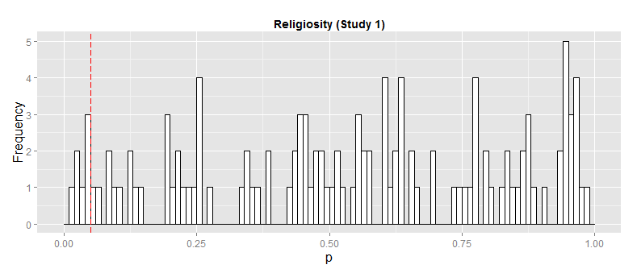
into the multiverse
6%
effect is too fragile to be taken seriously

Slide 27
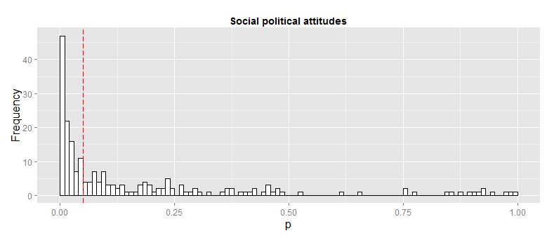
49%
the belief in the effect heavily depends on
the belief in the different processing choices

Slide 28
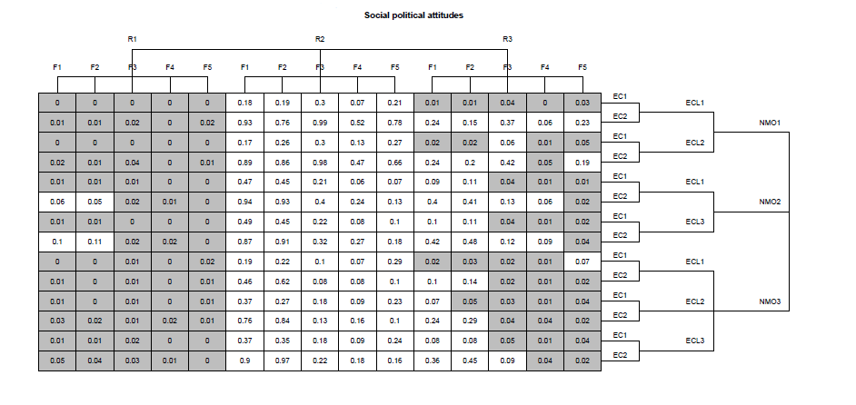
if you trust R1, there is evidence for a significant effect of fertility
if you trust R2, there is no evidence for a significant effect of fertility
if you trust R3, or have no reason to prefer certain choices
you are uncertain about the effect of fertility so you can’t draw a substantive conclusion about the effect of fertility
your only conclusion is a methodological one: the need to deflate the multiverse

Slide 29
deflating the data multiverse
reducing the number of arbitrary choices in data construction
better theory, e.g. on the relationship between cycle day and fertility
better measurement, e.g. better way of assessing fertility
surges in luteinizing hormone (e.g., durante et al., 2011)
better design, e.g., in assessing relationship status
dating or involved with only one partner is too ambiguous to be helpful

Slide 30
discussion
a multiverse analysis is not restricted to p-values alone
e.g., Bayes factors are equally sensitive to choices in data construction
when sharing your research data, share the raw data, not the processed data so that others can look at reasonable options you didn’t think of
thank you, kristina durante!
a multiverse analysis shows a small part only of a larger multiverse of statistical results
there is not only a data multiverse but also a model multiverse (e.g., patel, burford, & ioannidis, 2015, simonsohn, smmons, & nelson, 2015)

Slide 31
standardization is not a solution
if the standardization is merely a convention, then the robustness of a finding is still hidden
pre-registration of a single analysis is not a solution
it does prevent the exploitation of researcher degrees of freedom, but it still hides the robustness of the finding
unless the multiverse analysis is pre-registered

Slide 32
conclusion
data sets are often constructed rather than collected
data construction is often arbitrary
the statistical result is as arbitrary as the data construction
reporting a single data set analysis can be misleading
we should work hard to reduce the multiverse of data sets
we should both report the multiverse of statistical results
to show the robustness or fragility of a finding
to help identifying the sources of the fragility

Slide 33
references
Durante, K. M., & Arsena, A. R. (2015). Playing the field: The effect of fertility on women’s desire for variety. Journal of Consumer Research, 41, 1372–1391.
Durante, K. M., Griskevicius, V., Cantú, S. M., & Simpson, J. A. (2014). Money, status, and the ovulatory cycle. Journal of Marketing Research, 51, 27–39.
Durante, K. M., Griskevicius, V., Hill, S. E., Perilloux, C., & Li, N. P. (2011). Ovulation, female competition, and product choice: Hormonal influences on consumer behavior. Journal of Consumer Research, 37 , 921–934.
Durante, K. M., Griskevicius, V., Simpson, J. A., Cantú, S. M., & Li, N. P. (2012). Ovulation leads women to perceive sexy cads as good dads. Journal of Personality and Social Psychology, 103 , 292–305.
Durante, K. M., Rae, A., & Griskevicius, V. (2013). The fluctuating female vote: Politics, religion, and the ovulatory cycle. Psychological Science, 24 , 1007–1016.
Gelman, A., & Loken, E. (2014). The statistical crisis in science. American Scientist, 102, 460–465.
Patel, C. J., Burford, B., & Ioannidis, J. P. (2015). Assessment of vibration of effects due to model specification can demonstrate the instability of observational associations. Journal of Clinical Epidemiology, 68 (9), 1046–1058.
Simmons, J. P., Nelson, L. D., & Simonsohn, U. (2011). False-positive psychology: Undisclosed flexibility in data collection and analysis allows presenting anything as significant. Psychological Science, 22 , 1359–1366.
Simonsohn, U., Simmons, J.P. , & Nelson, L. (2015)., Specification Curve: Descriptive and Inferential Statistics on All Reasonable Specifications . Available at SSRN
Wicherts JM, Veldkamp CL, Augusteijn HE, Bakker M, van Aert RC, van Assen MA. Degrees of freedom in planning, running, analyzing, and reporting psychological studies: a checklist to avoid p-hacking. Front.iers in Psychology. 7, 1832 (2016).

Slide 34
increasing transparency through a multiverse analysis
reference: steegen, s, tuerlinckx, f., gelman, a., & vanpaemel, w. (2016). increasing transparency through a multiverse analysis. perspectives on psychological science, 11, 702-712.
osf project page: https://osf.io/zj68b/ (code, data, slides, shiny app, etc)
email : wolf.vanpaemel@kuleuven.be

